Slide 1
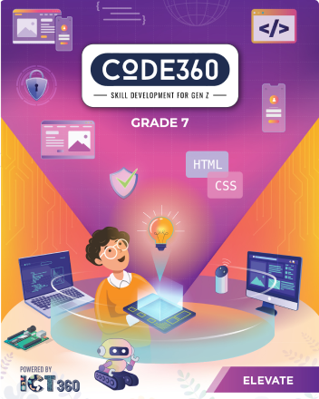
Mazen
Saad
Computer Teacher

Slide 2
ICT
Grade 7

Slide 3

Enter the notebook and write the following:

Slide 4

Lesson title
3D Environment
The Date
2025 / 9 /

Slide 5


Do you know what 3d environment is?

Slide 6

3D Environment :
A 3D environment is a computer-generated, three-dimensional digital space with depth and volume, allowing users to interact with virtual objects and simulated real-world scenarios.

Slide 7
What We'll Learn Today
1
3D
2
Environment
3
Modeling
4
Rendering

Slide 8

Start

Slide 9
Do you know the meaning of this sign?

Slide 10
Think carefully

Slide 11


Slide 12


Slide 13


Slide 14


Slide 15

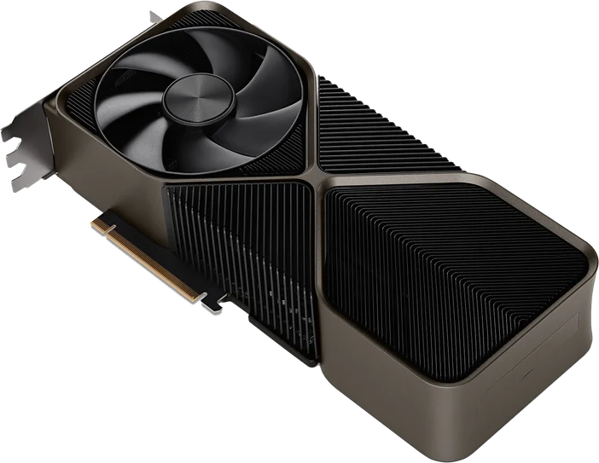

Slide 16

Exercise

Slide 17
Page Number 04

Slide 18
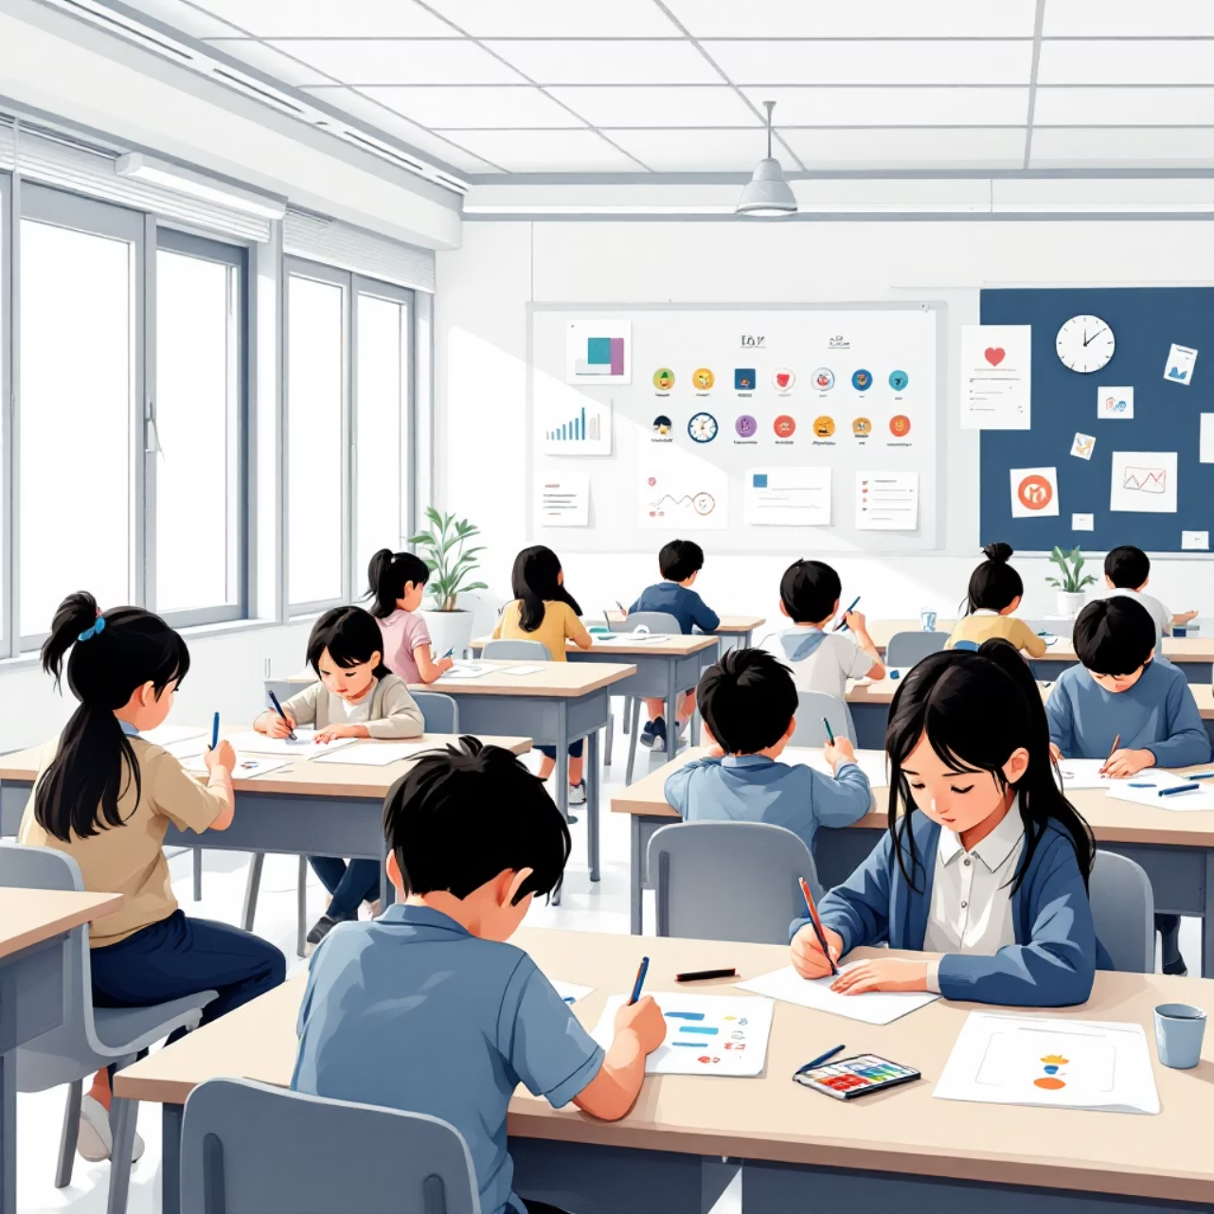

Slide 19

Do you have any other questions?

